Slide 1
Energy Networks Association
ENA TS 48-4 Issue 6 2021
Revision Summary
30th December 2021

Slide 2
ENA TS 48-4 Issue 6 2021 Revision Summary
DC trip relays associated with a tripping function in protection systems
DOCUMENT PURPOSE
To specify the design, performance, testing requirements and application of direct current auxiliary relays intended to act as independent trip relays.
SCOPE
To detail the functional test requirements for newly introduced DC trip relays.
To detail the information to be provided to the ENA Member Companies by the manufacturer/supplier.
This ENA TS applies to protection equipment intended for use in the UK Electricity Supply Industry.
HISTORY
1st issued: in 1976
Re-issued in 1980, 1983, 2010 with a 5th minor revision in 2016
2021: 6th medium revision as detailed overleaf
2

Slide 3
ENA TS 48-4 Issue 6 2021 Revision Summary
Summary of Amendments
Reference to BS EN 61810-1 updated to include new addendum issued in 2020.
Reference to BS EN 61810-2 updated following new issue in 2017.
Removal of reference to BS EN 60255-24 (COMTRADE) as this is not considered relevant to d.c. tripping relays.
Definition of time to failure (TTF) reworded.
Clause 4.2 – removed reference to ENA 60255-24.
Clause 4.6 – added requirement of Manufacturer to specify maximum duty of each contact.
Throughout Clause 5, replaced the word ‘capacity’ with ‘capability’.
Table 4 removed and replaced by bullet points.
Corrected error in Clause 7.1 that incorrectly referenced 61820-2.
Annex A item 6 removed as not required.
Annex B removed reference to 4.3.3 (auxiliary contacts) as this does not exist in this document.
Nature of Revision
Medium
Key Points
First Issued in 1976
No major technical changes
Normative references updated
3

Slide 4
ENA TS 48-4 Issue 6 2021 Revision Summary
Who is affected and why?
ENA Member Company staff, who are primarily tasked with the procurement, approval, application, inspection and testing of newly introduced DC trip relays.
Manufacturers/Suppliers of DC trip relays.
4

Slide 5
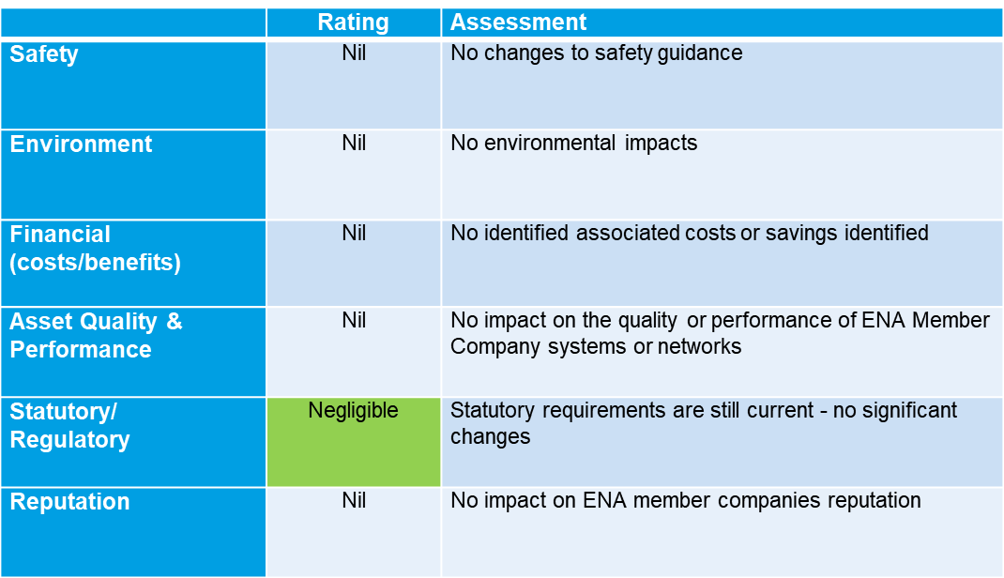
ENA TS 48-4 Issue 6 2021 Revision Summary
Impact Assessment
5

Slide 6
© ENA 2020
6

